Slide 1


Game Engines 1
Quaternions
Dr Bryan Duggan
DIT School of Computing
bryan.duggan@dit.ie
@ditcomputing
http://facebook.com/ditschoolofcomputing

Slide 2
Questions we will answer today
What does Eamonn DeValara have to do with games?
How do rotations work in 3D?
Quaternions!

Slide 3
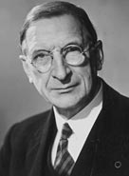
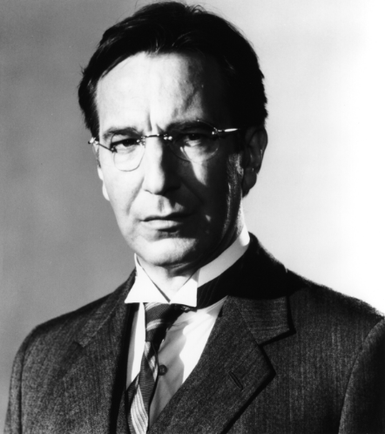
Eamon de Valera was born in Manhattan, New York, on 14th October 1882
Elected for East Clare in the general election. On 21 January 1919
Supported the anti-Treaty Republicans During the Civil War of 1922-1923
Founded Fianna Fail in May 1926
Founded the Irish Press, in September 1931
Elected President of Ireland in 1959

Slide 4
Revision…
Use 3 vectors
Look, Up and Right
Yaw – Rotation around the Global Up Axis
Pitch – Rotation around Right Axis
Roll – Rotation around the Look Axis
Look Vector – A Unit Vector giving the orientation of an object
The direction something is pointing

Slide 5
Revision…
Use 4 x 4 matrices to represent a transformation
E.g. World, View, Projection
Use the glm::mat4 class to represent a 4 x 4 matrix
Use 1 for the 4th element of the vector matrix
Multiply vectors by matrices
To do transformations
Multiply matrices by matrices
To combine transformations

Slide 6
Revision…
We can combine transformations together by multiplying the matrices together to get a single transformation matrix
This means we can apply the same transformations to the multiple vectors
The order that you multiply is the order the transformations are carried out!!!

Slide 7
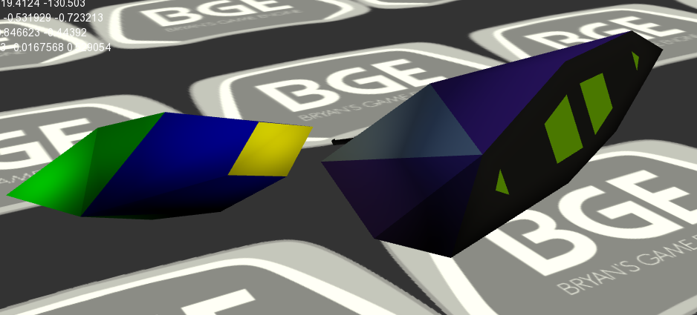
Orientation in 3D
Orientation
placement of an object in a rotational coordinate system with respect to a fixed point and a reference position
Rotation
A circular movement of an object around a centre point of rotation. A three-dimensional object rotates always around an imaginary line called a rotation axis. If the axis is within the body, and passes through its centre of mass the body is said to rotate upon itself, or spin. A rotation about an external point, e.g. the Earth about the Sun, is called a revolution
An object rotates to a new orientation

Slide 8
Representing Orientation using Euler Angles
A 3D Vector:
X = Pitch
Y = Yaw
Z = Roll
The axes move with the object
A sequence of rotations is called an Euler Angle Sequence
Any of the following 12 sequences are valid:
XYZ XZY XYX XZX
YXZ YZX YXY YZY
ZXY ZYX ZXZ ZYZ

Slide 9
Euler Angles
This gives us 12 redundant ways to store an orientation using Euler angles
Different industries use different conventions for handling Euler angles
Disadvantages:
Many possible orderings
x(90)y(90) is different from y(90)x(90)
How do we interpolate between two orientations?
How do we check for equality?

Slide 10
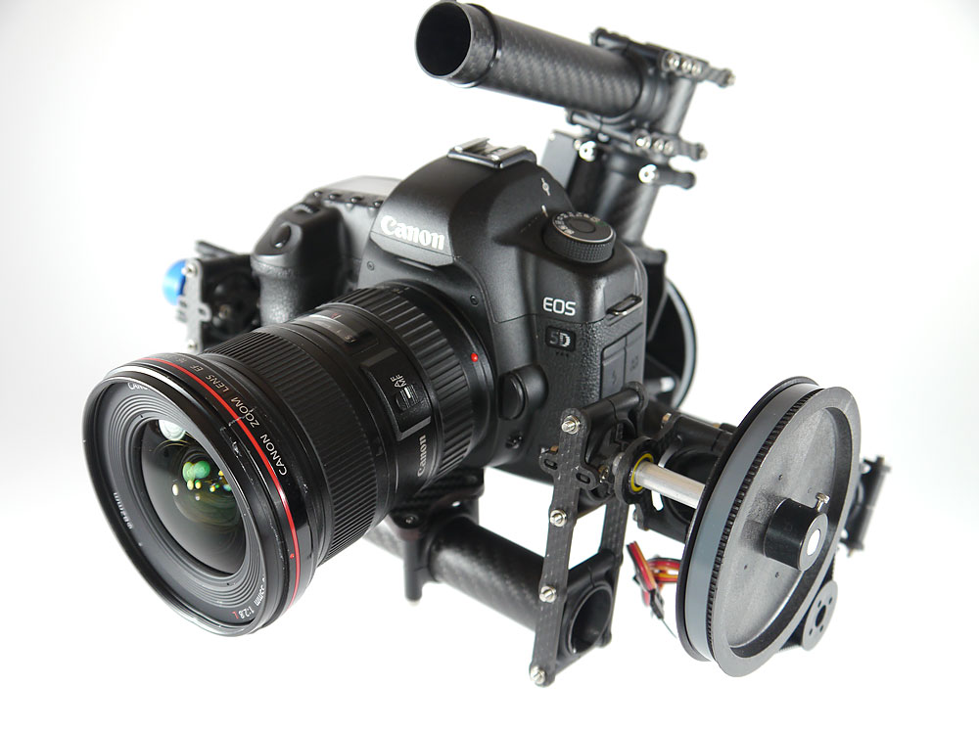
Gimbals
A Gimbal is a hardware implementation of Euler angles used for mounting gyroscopes/cameras etc
Gimbal lock is a basic problem with representing 3D rotation using Euler angles…

Slide 11
Gimbal Lock
When two axes line up, this results in a loss of a degree of freedom
Two rotations around different axis go in the same direction
Results in very weird animations
These are hard to understand on paper
See:
http://www.youtube.com/watch?v=rrUCBOlJdt4
http://www.youtube.com/watch?v=zc8b2Jo7mno

Slide 12
What does Interpolation mean?
Interpolation
Moving smoothly between two values
Easy for vectors & scalars
To interpolate between A and B
C = A + (B-A)t
P(t) = P0 + tL
Interpolation the translation is easy, but what about rotations?
How do you interpolate matrices or look vectors? Its very difficult!

Slide 13
Interpolating Euler Angles
Interpolate between the three values independently
This will result in the interpolation following a different path depending on which of the 12 schemes choosen
Interpolating beyond 90 degrees is a problem

Slide 14
Matrix Representation
A 3x3 matrix can represent rotation
This means we now have 9 numbers instead of 3, and therefore, we have 6 extra degrees of freedom
Whatever we use will need to be converted into a matrix in order to do anything useful (i.e. transform vertices)
Why then, shouldn’t we just always use matrices?
Numerical issues
Storage issues
Interpolation issues

Slide 15
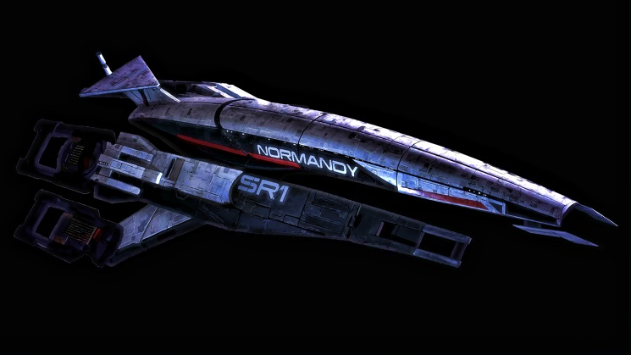
Look Vectors
Represent the direction an object is looking
Don’t really represent orientation at all, though related to orientation of an object

Slide 16
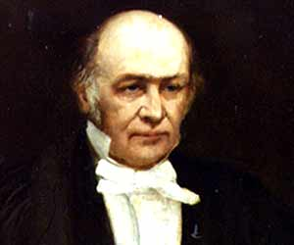
Quaternions
Quaternions are an interesting mathematical concept with a deep relationship with the foundations of algebra and number theory
Invented by William Rowan Hamilton
Most useful to us as a means of representing orientations
A quaternion has 4 components:
glm::quat(w, w, y, z)
This ordering is different in different API’s, so always check!!

Slide 17
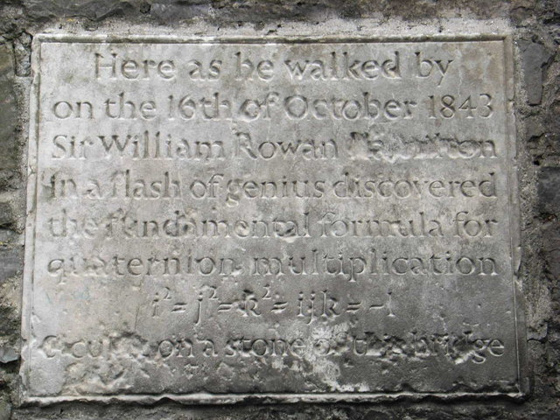
On 16 October 1843 Hamilton was out walking along the Royal Canal in Dublin with his wife when the solution in the form of the equation
occurred to him;
Hamilton then carved this equation using his penknife into the side of the nearby Broome Bridge
This event marks the discovery of the quaternion group.
A plaque under the bridge, was unveiled by the Taoiseach Éamon de Valera (himself a mathematician and student of quaternions) on November 13, 1958

Slide 18
Quaternions (Imaginary Space) – Feel free to Ignore!!
Quaternions are actually an extension to complex numbers
Of the 4 components, one is a ‘real’ scalar number, and the other 3 form a vector in imaginary ijk space!

Slide 19
Quaternions as Rotations
A quaternion can represent a rotation by an angle θ around a unit axis axis: q.w = cos(θ/2)
q.x = axis.x * sin(θ/2 )
q.y = axis.y * sin(θ /2 )
q.z = axis.z * sin(θ /2 )
If axis is unit length, then q will be also
NEVER make a quaternion like this. Instead use:
glm::quat rot = glm::angleAxis(angle, angle);

Slide 20
Unit Quaternions
A quaternion must be normal to represent rotations
glm::normalize(q);
The same as normalising a vector
Divide each component by the length (in 4D)

Slide 21
Quaternion Multiplication
(Q1 * Q2).w = (Q1.wQ2.w - Q1.xQ2.x - Q1.yQ2.y - Q1.zQ2.z)
(Q1 * Q2).x = (Q1.wQ2.x + Q1.xQ2.w + Q1.yQ2.z - Q1.zQ2.y)
(Q1 * Q2).y = (Q1.wQ2.y - Q1.xQ2.z + Q1.yQ2.w + Q1.zQ2.x)
(Q1 * Q2).z = (Q1.wQ2.z + Q1.xQ2.y - Q1.yQ2.x + Q1.zQ2.w)
If Q1 and Q2 are rotations, then Q1 * Q2 is the same as rotation by Q2 and then Q1
This is AMAZINGLY USEFUL!!
Two unit quaternions multiplied together will result in another unit quaternion

Slide 22
Consider…
Combining the orientation quaternion from the oculus rift with the quaternion from a game controller:
OVR::Quatf hmdOrient = m_SFusion.GetOrientation();
glm::quat headOrientation = OVRToGLQuat(hmdOrient);
// Combine the orientation of the head with the yaw from the XBOX controller...
orientation = xboxController->orientation * headOrientation;
//position = xboxController->position;
// Now update the XBOX Controller Look vectors
glm::quat tempQ = xboxController->orientation;
xboxController->orientation = orientation;
xboxController->RecalculateVectors();
xboxController->orientation = tempQ;

Slide 23
Constructing a Quaternion
glm::quat q; \\ The identity
glm::angleAxis(thetaInDegrees, axis);

Slide 24
Rotating a Vector by a Quaternion
Rotate a vector by a quaternion:
w = q * w * q⁻¹
Where q = quaternion and w = a pure quaternion made from the vector to be rotated (w = 0)
This is called CONJUGATION

Slide 25
Converting Quaternions
Convert a quaternion to a matrix:
glm::mat4_cast(orientation)
Convert a matrix to a quaternion:
glm::quat_cast(matrix)

Slide 26
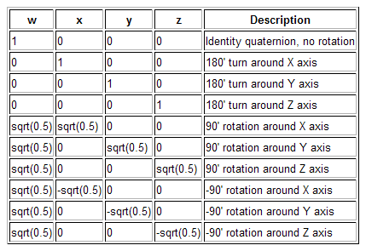
Some useful quaternions

Slide 27
Quaternion Interpolation

Slide 28
Linear Interpolation
If we want to do a linear interpolation between two points a and b in normal space
Lerp(t,a,b) = (1-t)a + (t)b
where t ranges from 0 to 1
Note that the Lerp operation can be thought of as a weighted average (convex)
We could also write it in it’s additive blend form:
Lerp(t,a,b) = a + t(b-a)

Slide 29
Spherical Linear Interpolation
If we want to interpolate between two points on a sphere (or hypersphere), we don’t just want to Lerp between them
Instead, we will travel across the surface of the sphere by following a ‘great arc’

Slide 30
Spherical Linear Interpolation
We define the spherical linear interpolation of two unit vectors in N dimensional space as:

Slide 31
In Code:
glm::quat q = glm::mix(q1, q2, t);
Where t is a value between 0 and 1
This is one of the most important uses of quaternions
Very difficult to do skeletal animations without using quaternion slerp
Consider how you animate from one key frame to the next.

Slide 32
Quaternion camera
Walk & strafe work the same
Yaw, pitch & roll use quaternions and effect the objects orientation quaternion
The objects vectors are then recalculated from the quaternion
Use w = q * w * q⁻¹

Slide 33
Yaw
void GameComponent::Yaw(float angle)
{
// A yaw is a rotation around the global up vector
glm::quat rot = glm::angleAxis(angle, GameComponent::basisUp);
orientation = rot * orientation;
}

Slide 34
Pitch
void GameComponent::Pitch(float angle)
{
// Make sure we don’t flip over…
float invcosTheta1 = glm::dot(look, basisUp);
float threshold = 0.95f;
if ((angle < 0 && invcosTheta1 < (-threshold)) || (angle > 0 && invcosTheta1 > (threshold)))
{
return;
}
// A pitch is a rotation around the right vector
glm::quat rot = glm::angleAxis(angle, right);
orientation = rot * orientation;
}

Slide 35
Roll
void GameComponent::Roll(float angle)
{
// A roll is a rotation around the look vector
glm::quat rot = glm::angleAxis(angle, look);
orientation = rot * orientation;
moved = true;
}

Slide 36
Keeping the vectors in sync
void GameComponent::RecalculateVectors()
{
look = RotateVector(basisLook, orientation);
right = RotateVector(basisRight, orientation);
up = RotateVector(basisUp, orientation);
}

Slide 37
RotateVector using the equation
glm::vec3 BGE::RotateVector(glm::vec3 v, glm::quat q)
{
glm::quat qinv = glm::inverse(q);
glm::quat w = glm::quat(0, v.x, v.y, v.z);
w = q * w * qinv;
return glm::vec3(w.x, w.y, w.z);
}

